Slide 1
Central Processing Unit (CPU)

Slide 2
von Neumann/Turing
Stored Program concept
Main memory storing programs and data
ALU operating on binary data
Control unit interpreting instructions from memory and executing
Input and output equipment operated by control unit
Princeton Institute for Advanced Studies
IAS
Completed 1952

Slide 3
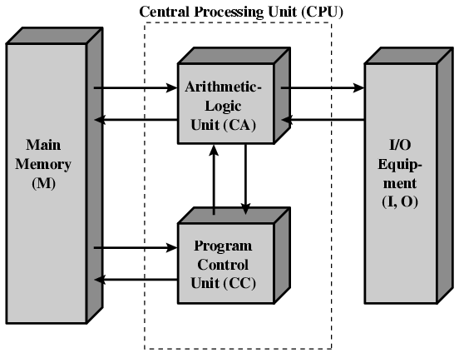
Structure of von Neumann machine

Slide 4
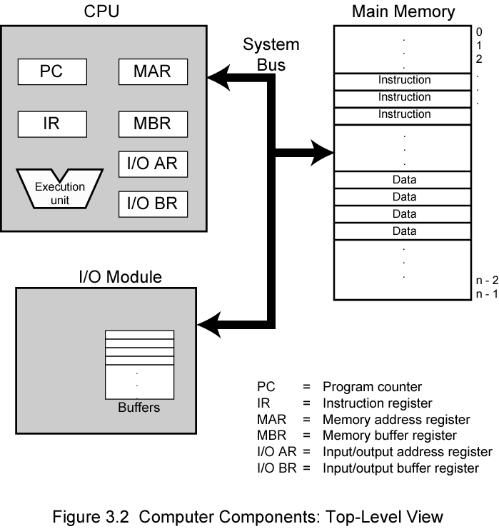
Computer Components: Top Level View

Slide 5
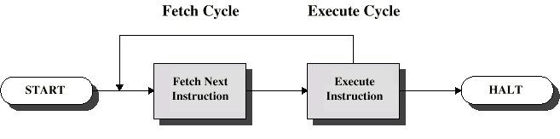
Instruction Cycle
Two steps:
Fetch
Execute

Slide 6
Fetch Cycle
Program Counter (PC) holds address of next instruction to fetch
Processor fetches instruction from memory location pointed to by PC
Increment PC
Unless told otherwise
Instruction loaded into Instruction Register (IR)
Processor interprets instruction and performs required actions

Slide 7
Execute Cycle
Processor-memory
data transfer between CPU and main memory
Processor I/O
Data transfer between CPU and I/O module
Data processing
Some arithmetic or logical operation on data
Control
Alteration of sequence of operations
e.g. jump
Combination of above

Slide 8
Interrupts
Mechanism by which other modules (e.g. I/O) may interrupt normal sequence of processing
Program
e.g. overflow, division by zero
Timer
Generated by internal processor timer
Used in pre-emptive multi-tasking
I/O
from I/O controller
Hardware failure
e.g. memory parity error

Slide 9
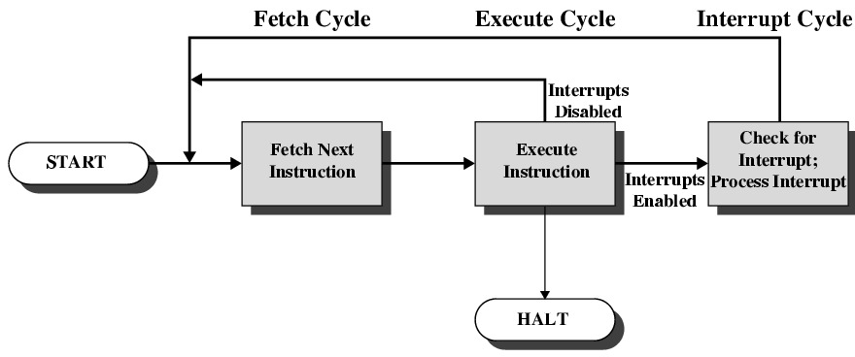
Instruction Cycle with Interrupts

Slide 10
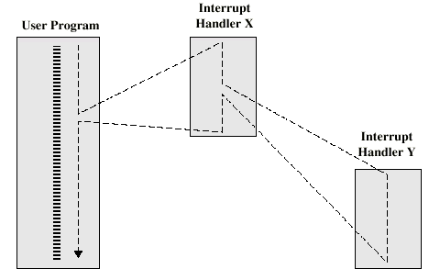
Multiple Interrupts – Nested

Slide 11
Connecting
All the units must be connected
Different type of connection for different type of unit
Memory
Input/Output
CPU

Slide 12
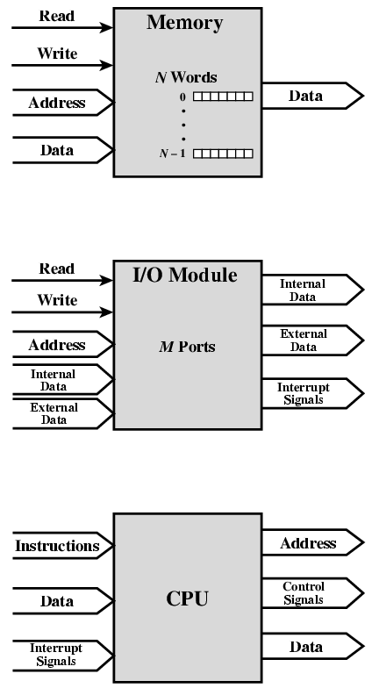
Computer Modules

Slide 13
Memory Connection
Receives and sends data
Receives addresses (of locations)
Receives control signals
Read
Write
Timing

Slide 14
Input/Output Connection(1)
Similar to memory from computer’s viewpoint
Output
Receive data from computer
Send data to peripheral
Input
Receive data from peripheral
Send data to computer

Slide 15
Input/Output Connection(2)
Receive control signals from computer
Send control signals to peripherals
e.g. spin disk
Receive addresses from computer
e.g. port number to identify peripheral
Send interrupt signals (control)

Slide 16
CPU Connection
Reads instruction and data
Writes out data (after processing)
Sends control signals to other units
Receives (& acts on) interrupts

Slide 17
What is a Bus?
A communication pathway connecting two or more devices
Usually broadcast
Often grouped
A number of channels in one bus
e.g. 32 bit data bus is 32 separate single bit channels
Power lines may not be shown

Slide 18
Data Bus
Carries data
Remember that there is no difference between “data” and “instruction” at this level
Width is a key determinant of performance
8, 16, 32, 64 bit

Slide 19
Address bus
Identify the source or destination of data
e.g. CPU needs to read an instruction (data) from a given location in memory
Bus width determines maximum memory capacity of system
e.g. 8080 has 16 bit address bus giving 64k address space

Slide 20
Control Bus
Control and timing information
Memory read/write signal
Interrupt request
Clock signals

Slide 21
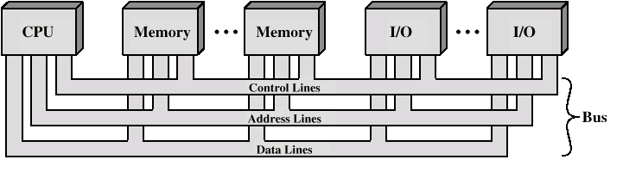
Bus Interconnection Scheme

Slide 22
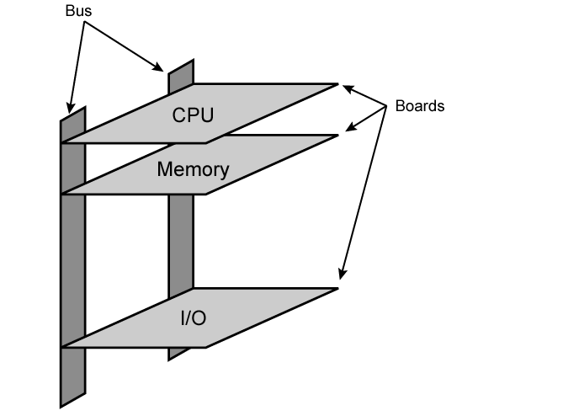
Physical Realization of Bus Architecture

Slide 23
Elements of an Instruction
Operation code (Op code)
Do this
Source Operand reference
To this
Result Operand reference
Put the answer here
Next Instruction Reference
When you have done that, do this...
Notes:
3

Slide 24
Instruction Representation
In machine code each instruction has a unique bit pattern
For human consumption (well, programmers anyway) a symbolic representation is used
e.g. ADD, SUB, LOAD
Operands can also be represented in this way
ADD A,B
Notes:
5

Slide 25
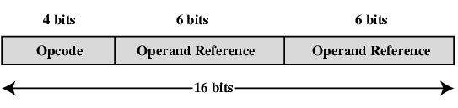
Simple Instruction Format

Slide 26
Addressing Modes
Immediate
Direct
Indirect
Register
Register Indirect
Displacement (Indexed)
Stack
Notes:
2

Slide 27
Immediate Addressing Diagram
Instruction
Opcode
Operand
Notes:
4

Slide 28
Direct Addressing Diagram
Instruction
Opcode
Address A
Memory
Operand
Notes:
6

Slide 29
Indirect Addressing Diagram
Instruction
Opcode
Address A
Memory
Pointer to operand
Operand
Notes:
9

Slide 30
Register Addressing (1)
Operand is held in register named in address filed
EA = R
Limited number of registers
Very small address field needed
Shorter instructions
Faster instruction fetch
Notes:
10

Slide 31
Register Addressing (2)
No memory access
Very fast execution
Very limited address space
Multiple registers helps performance
Requires good assembly programming or compiler writing
N.B. C programming
register int a;
c.f. Direct addressing
Notes:
11

Slide 32
Register Addressing Diagram
Instruction
Opcode
Register Address R
Registers
Operand
Notes:
12

Slide 33
Register Indirect Addressing Diagram
Instruction
Opcode
Register Address R
Memory
Registers
Pointer to Operand
Operand
Notes:
14

Slide 34
Processor Structure
CPU must:
Fetch instructions
Interpret instructions
Fetch data
Process data
Write data
Notes:
22

Slide 35
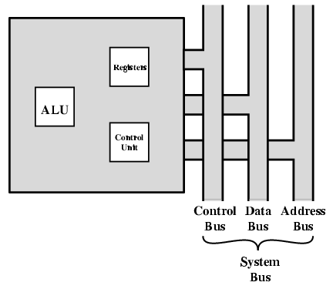
CPU With Systems Bus

Slide 36
Registers
CPU must have some working space (temporary storage)
Called registers
Number and function vary between processor designs
One of the major design decisions
Top level of memory hierarchy
Notes:
23

Slide 37
User Visible Registers
General Purpose
Data
Address
Condition Codes
Notes:
24

Slide 38
General Purpose Registers
May be true general purpose
May be restricted
May be used for data or addressing
Data
Accumulator
Addressing
Segment
Notes:
25

Slide 39
General Purpose Registers (2)
Make them general purpose
Increase flexibility and programmer options
Increase instruction size & complexity
Make them specialized
Smaller (faster) instructions
Less flexibility
Notes:
26

Slide 40
How Many GP Registers?
Between 8 - 32
Fewer = more memory references
More does not reduce memory references and takes up processor real estate
See also RISC
Notes:
27

Slide 41
Condition Code Registers
Sets of individual bits
e.g. result of last operation was zero
Can be read (implicitly) by programs
e.g. Jump if zero
Can not (usually) be set by programs
Notes:
29

Slide 42
Control & Status Registers
Program Counter
Instruction Decoding Register
Memory Address Register
Memory Buffer Register
Notes:
30

Slide 43
Program Status Word
A set of bits
Includes Condition Codes
Sign of last result
Zero
Carry
Equal
Overflow
Interrupt enable/disable
Supervisor
Notes:
31

Slide 44
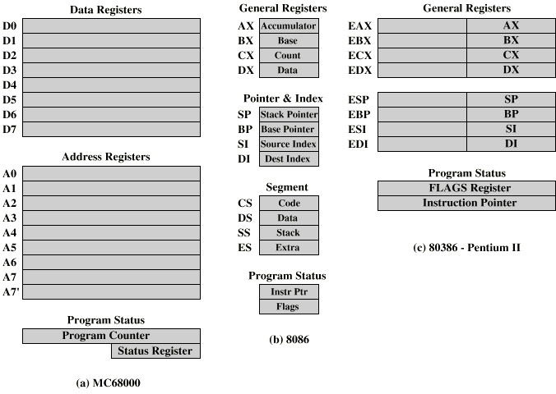
Example Register Organizations

Slide 45
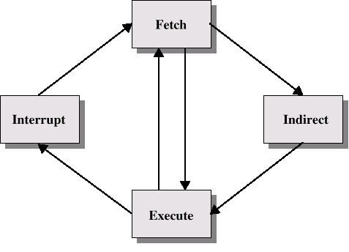
Instruction Cycle with Indirect

Slide 46
Data Flow (Instruction Fetch)
Depends on CPU design
In general:
Fetch
PC contains address of next instruction
Address moved to MAR
Address placed on address bus
Control unit requests memory read
Result placed on data bus, copied to MBR, then to IR
Meanwhile PC incremented by 1

